Slide 1
Data analysis for choosing a new location for a store

Slide 2
Introduction
The similarity of neighborhoods has been an important consideration in decision in choosing business location and city planning.
The availability of large location data makes data analysis and visualization possible. Statistical methods and machine learning approaches enables decision making based on quantitative analysis, which is more evidence-informed, robust, objective and comprehensive.
Assume you are a store owner in Toronto in one of the neighborhoods and you want to change location for a new shop.

Slide 3
Data
Foursquare location data
postal code information from Wikipedia
enables the visualization of results, analysis and interpretation
large scale, short time, low computational cost and financial cost

Slide 4
Methodology
Python was used for data analysis.
K-mean clustering was used to cluster similar neighborhoods.
A wide range of statistical methods were used to explore data structure and foster interpretation.
Folium package was used to visualize data on an interactive map.

Slide 5
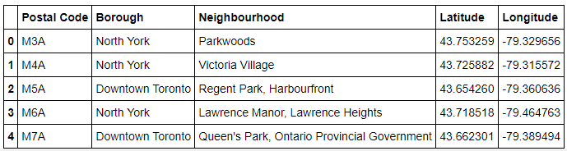
(1)Data loading and preparation

Slide 6
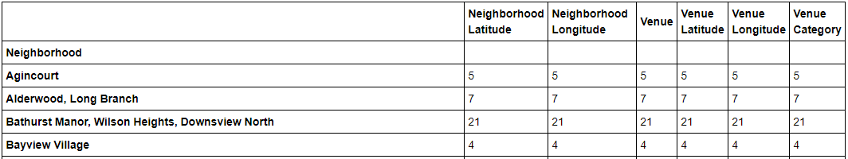
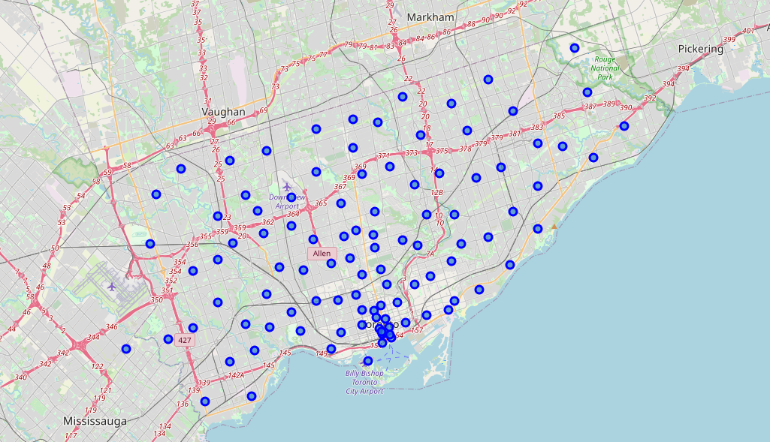
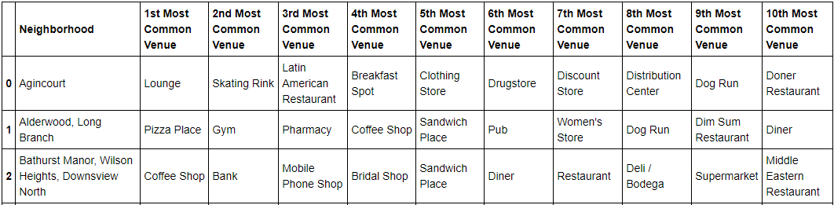
(2)Data exploratory analysis

Slide 7
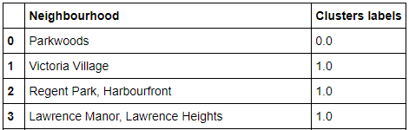
(3)Machine Learning and clustering

Slide 8
Results
9, 88, 1, 1, 1 boroughs in each cluster
First cluster: Caledonia-Fairbanks, East Toronto, Broadview North (Old East York).
Second cluster: Victoria Village, Regent Park, Harbourfront
Third cluster: York Mills, Silver Hills
Fourth cluster: West Deane Park, Princess Gardens, Martin Grove, Islington and Cloverdale
Fifth cluster: Malvern and Rouge

Slide 9
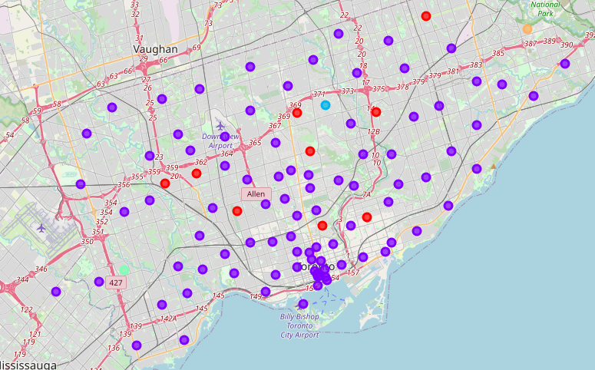

Slide 10
Discussion
Most neighborhoods are concentrated in the second cluster
may suggest the high similarity between neighborhoods
different functional areas in the city may not be distinct
clusters are embedded inside, no clear

Slide 11
a change of location based on where the shop is originally located,
located in the neighborhoods of the second cluster, it should not be a problem moving to most of the places in the city (only taking account of venue categories), same for the first cluster.
moving from York Mills, Silver Hills, West Deane Park, Princess Gardens, Martin Grove, Islington, Cloverdale, Malvern and Rouge could be more challenged.
the embedding distribution, located in the neighborhoods of last three clusters could still be within customers' travel range and attract customers.
many other factors are also of great importance.

Slide 12
Conclusion
Change of location should be based on where the shop is originally located.
Most neighborhoods are concentrated in the second cluster.
Other factors also play an important part.
Thank you

